Slide 1
Pre-processor

Slide 2
Pre-processor
1st stage of compilation, in multistage compilation.
A preprocessor is a program that processes our source program before it is passed to the next stage i.e. Translator
The preprocessor works on the source code and creates “expanded source code” → i/p is ‘C’ text file, o/p also C text file
The preprocessed code is also known as pure-c-code
Command to compile program up to preprocessor stage is
  gcc –E filename.c –o filename.i
  prog.c
  prog.i
Pre-processor

Slide 3
Pre-processor
Features of Preprocessor :
1. Each preprocessor directives starts with '#'.
2. There should be one preprocessor directive for one line.
3. To extend preprocessor into multiple lines, then use ('\') at end.
4. The preprocessor directives doesn't end with semicolon (';').
5. Some of the preprocessor directive are
#define, #include, #if, #else, #elif, #endif, #undef,#pragma, #ifdef, #ifndef.

Slide 4
Pre-processor
Operations of Preprocessor :
Following operations are performed by preprocessors
1. File Inclusions.
2. Removal of comments.
3. Macros substitutions.
4. Conditional compilation.

Slide 5
header file inclusion
Include the header files is in 2 ways.
#include< > #include “ “
#include< >:
Here, the pre-processor searches for header files in a predefined path i.e. /usr/include/
#include “ “:
Here, the pre-processor searches the header file in a present working directory, if it is not found then it searches predefined path /usr/include/
Is header file inclusion must?

Slide 6
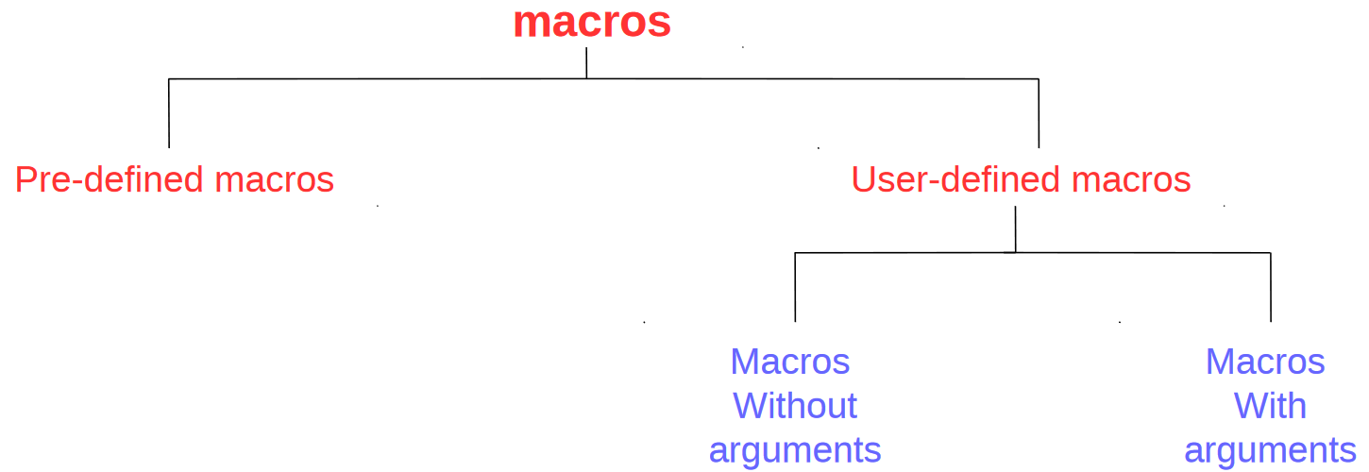
Macros

Slide 7
Macros
The #define preprocessor directive is used to define constant or macro substitution.
Syntax:
#define macro_name macro_expansion
Macros may use in place of functions
  In small codes
  Without using recursion

Slide 8
Macros
Why Macros?
Looks like function, but replaces code (execution time less)
Looks like variable, behaves as constant
Pre-processors arrangement makes application executes faster

Slide 9
Pre-defined Macros
#include <stdio.h>
int main()
{
printf("line no : %d\n",__LINE__); //represents current line number
printf("file name : %s\n",__FILE__); //represents current file name
printf("time : %s\n",__TIME__); //represents compile time in "HH:MM:SS" format
printf("date : %s\n",__DATE__); //represents compile date in "MMM DD YYYY" format
printf("%d\n",(int)NULL);
printf("%d\n",EOF);
}

Slide 10
User defined macros without arguments
Examples:
#define TRUE 1
#define FALSE 0
#define PI 3.14
#define MAX 100
#define MIN 0
#define AGE 50
#define AND &&
#define OR ||
#define superloop_starts while(1)
#define PRINT_ERROR printf(“Error”);
#define NEW_LINE printf(“\n”);
Examples:
#define LED_AH 7
#define LED_AL 8
#define SW1_AH 10
#define SW2_AL 1
#define LCD_DATA P0

Slide 11
User defined macros without arguments
Is macro without body allowed?
Yes. It is possible to define macro with out any macro expansion/body.
For example,
#define TEST
What is the use of macro without body?
In conditional compilation.
  #ifdef
  #else
  #endif
  #if
  #elif
  #ifndef

Slide 12
User defined macros with arguments
Examples:
#define SUM(a,b) a+b
#define MAX(x,y) ((x)>(y) ? (x) : (y))
#define MIN(x,y) ((x)<(y) ? (x) : (y))
#define SQUARE(x) ((x)*(x))
#define ISUPPER(x) (x>=65 && x<=90)
#define ISLOWER(x) (x>=97 && x<=122)
#define PRINT_NEWLINES(n) {int i; for(i=0;i<n;i++) printf(“\n”); }

Slide 13
User defined macros with arguments
#define SETBIT(DATA,BITPOS) (DATA |= 1<<BITPOS)
#define CLRBIT(DATA,BITPOS) (DATA &= ~(1<<BITPOS))
#define CPLBIT(DATA,BITPOS) (DATA ^= 1<<BITPOS)
#define TESTBIT (DATA,BITPOS) ((DATA>>BITPOS)&1)
Binary equivalent of given integer:
for(bitpos=31;bitpos>=0;bitpos--)
printf(“%d ”,(data>>bitpos)&1);
for(bitpos=31;bitpos>=0;bitpos--)
Printf(“%d ”,TESTBIT(data,bitpos));
int testbit(int data,int bitpos)
{
return ((data>>bitpos)&1);
}
for(bitpos=31;bitpos>=0;bitpos--)
printf(“%d ”,testbit(data,bitpos));

Slide 14
Points to be noted
1. If macro is accepting arguments, it is better to put parentheses around entire macro expansion and also around each argument.
2. No space between the macro_name and left parenthesis.
Reason: Macro expansion starts from the left parenthesis.
3. Don’t try to write recursive macros.
Reason: if macro name appears inside its own expansion, then it is not expanded.
Ex: #define FACT(x) x==0 ? 1 : FACT(x-1)
4. If the macro_name appears inside a character constant, string constant or a comment then it is not replaced …. Left as it is.
Ex: #define Hello 2
#define World! 3
printf(“Hello World!”);

Slide 15
Macro vs Function
#include<stdio.h>
#define SQUARE(x) ((x)*(x))
int main()
{
int k=5,s;
s=SQUARE(k++);
printf(“s=%d k=%d\n”,s,k);
return 0;
}
SQUARE(k++) … is expanded as ((k++)*(k++))
Output:
s=30 k=7
#include<stdio.h>
int SQUARE(int x)
{
return (x*x);
}
int main()
{
int k=5,s;
s=SQUARE(k++);
printf(“s=%d k=%d\n”,s,k);
return 0;
}
Output:
s=25 k=6

Slide 16
Nested Macros
#include<stdio.h>
#define SQUARE(x) ((x)*(x))
#define CUBE(x) (SQUARE(x)*x)
int main()
{
int a=10;
printf(“%d %d\n”, SQUARE(a),CUBE(a));
return 0;
}
Examples:
#define PI 3.14
#define PISQUARE PI*PI

Slide 17
Macros
Macro vs Variable
Scope

Slide 18
Conditional Compilation
Compilation of a part of code based on condition
Conditions are checked during the pre-processing phase.
Directives used:
#ifdef, #ifndef, #if, #else, #elif, #endif, #undef
Note: Every #if directive should end with #endif

Slide 19
Conditional Compilation
Syntax:
#if constant-expression
statements / logic
#endif
#if constant-expression
statements / logic
#else
statements / logic
#endif
#if constant-expression
statements / logic
#elif constant-expression
statements / logic
#elif constant-expression
statements / logic
#else
statements / logic
#endif

